Slide 1

Analysing Air Quality
By Amjad Jouria

Slide 2

Introduction
Primary pollutants are substances that are directly emitted into the atmosphere. Common ones include: PM2.5, PM10, NO2, SO2 and CO.
Long-term exposure to these pollutants can cause serious harm to humans, particularly children, elderly and people with pre-existing heart and lung conditions.
PM2.5 refers to the concentration of particulate matter that is under 2.5 micrometres in diameter, measured in ug/m3. These small particles are particularly dangerous as they are small enough to enter the bloodstream and deep into the lungs.
The insights from the following project can be used and built upon to guide regulations and interventions by policymakers and to inform and advise the public about health risks associated with bad air quality.

Slide 3
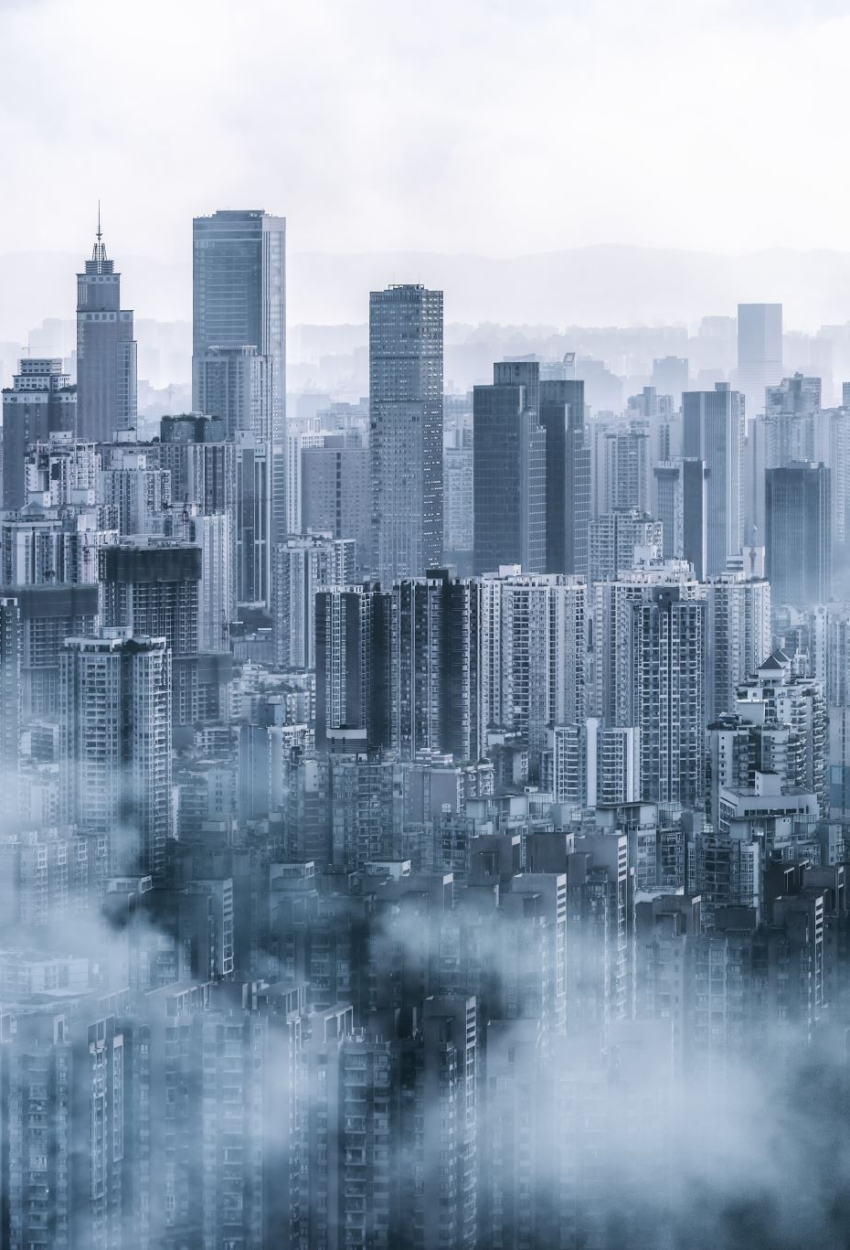
PROJECT aims
To create a threshold limit for each pollutant, a value at which everywhere should aim not to exceed.
Track changes in PM2.5 from 2017 – 2023 in over 6000 cities and identify places with a high level.
To examine the effect of primary pollutants (PM2.5, PM10, NO2, SO2, CO) on air quality.
To develop a predictive model to classify air quality into 3 categories: Good, Moderate, Poor.
Create applications that allows users to enter a city and find out the latest pm2.5 concentration, to input their own readings to return an air quality level.

Slide 4
This project uses two datasets which were retrieved from Kaggle.
Dataset 1 – Air quality ratings | Dataset 2 – Yearly PM2.5
5000 samples of regions with an air quality rating of Good, Moderate, Poor, Hazardous. All taken from Southeast Asian countries like India, Pakistan, Sri Lanka and Bangladesh. This set was used to develop the predictive model and determine the threshold limit for each feature. Preprocessing involved changing the “Air Quality” variable into numbers and then mapped so that: 0 = Good, 1 = Moderate, 2 & 3 = Poor This was necessary to allow us to create the predictive model. | Yearly PM2.5 concentration from 6985 cities across 133 countries from 2017 to 2023. This will be used to identify places with dangerous levels of PM2.5, as well as comparing overall levels across the years. It will show the cities and countries that are most in need of regulations. The data was aggregated from over 30,000 air quality monitoring systems and sensors. Data source: https://www.iqair.com/

Slide 5
Key Features:
Temperature (°C): Average temperature of the region.
Humidity (%): Relative humidity recorded in the region.
PM2.5 Concentration (µg/m³): Fine particulate matter levels.
PM10 Concentration (µg/m³): Coarse particulate matter levels.
NO2 Concentration (ppb): Nitrogen dioxide levels.
SO2 Concentration (ppb): Sulfur dioxide levels.
CO Concentration (ppm): Carbon monoxide levels.
Proximity to Industrial Areas (km): Distance to the nearest industrial zone.
Population Density (people/km²): Number of people per square kilometer in the region.
Target Variable: Air Quality Levels
Good: Clean air with low pollution levels.
Moderate: Acceptable air quality but with some pollutants present.
Poor: Noticeable pollution that may cause health issues for sensitive groups.
Hazardous: Highly polluted air posing serious health risks to the population.

Slide 6
The threshold
Pollutant | WHO limit 2005 | WHO limit 2021 | Our limit
PM2.5 | 15 | 15 | 15
PM10 | 50 | 45 | 20
NO2 | - | 25 | 40
SO2 | 20 | 40 | 20
CO | - | 4 mg/m3 | 2 mg/m3
We started by taking the average values from all the rows that were assigned a “Good” or “Moderate” air quality. These were rounded down to create a threshold limit for each primary pollutant, which we can compare to the WHO guidelines…
From this we are proposing that the guidelines are revised for 2026, lowering the recommended limit for PM10, SO2 and CO, whilst keeping the same limit for PM2.5 and NO2.
Although these would ideally be lower, we understand that we must remain realistic, and that PM2.5 and NO2 are very abundant in urban areas due to traffic and industrial emissions
The results also showed that regions more than 12km away from industrial areas tend to have good air quality, which can be taken into account when building new houses or apartment blocks.

Slide 7
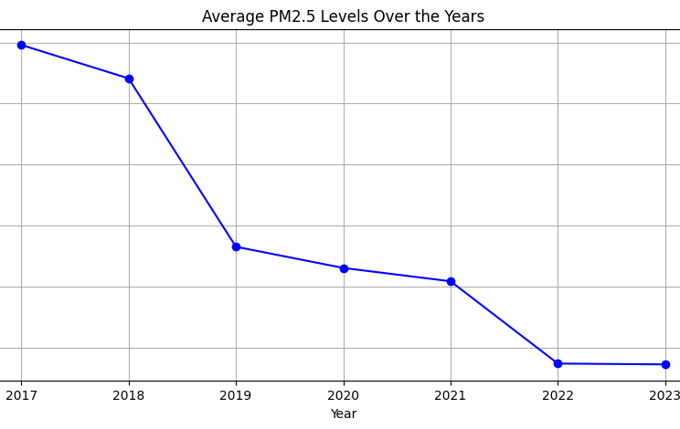
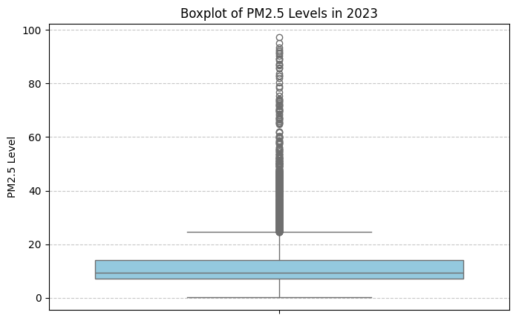
Pm2.5 concentration from 2017-2023
The data shows a yearly decrease in average PM2.5 levels across the 6985 cities which is a positive.
While the average is good, we can see that there are many outliers.
A total of 1611 cities from 92 countries had a PM2.5 level in 2023 that exceeded the limit of 15 ug/m3.
China, India, Thailand, South Korea and Poland have the most cities that are above the limit.

Slide 8
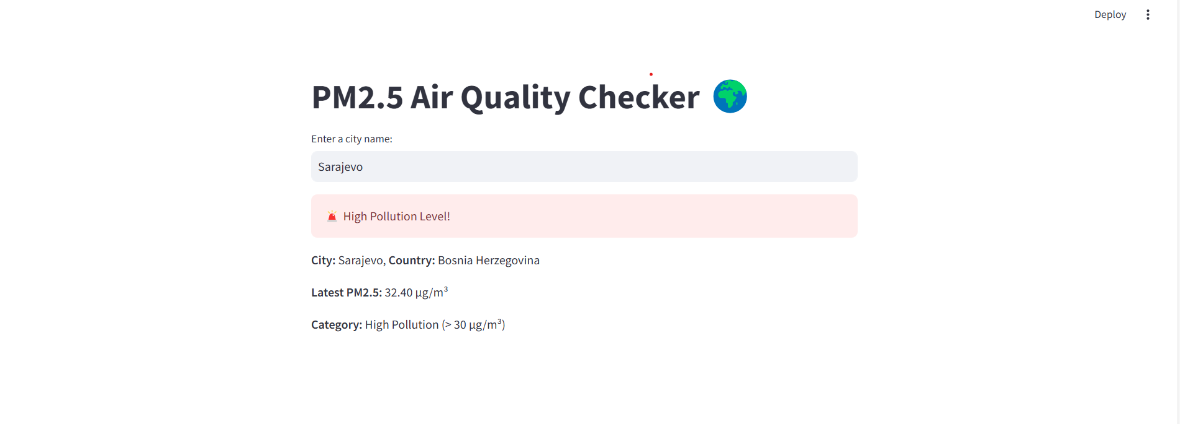
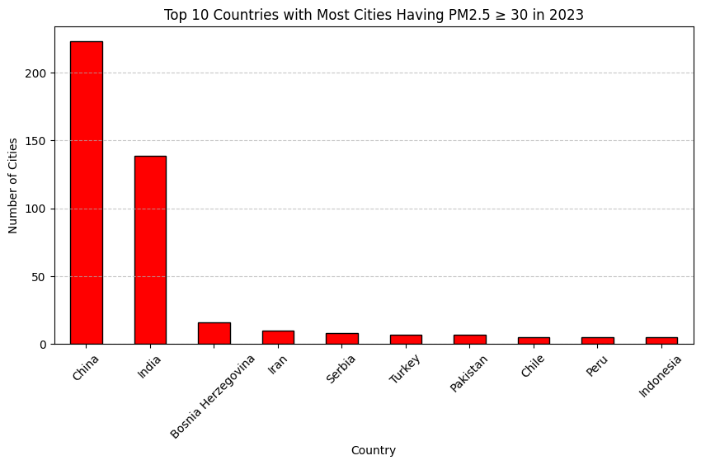
Visualization of the top 10 countries that have the most cities with a PM2.5 level of 30 or more in 2023, of which there are 485 across 45 countries.
We also created an app that allows users to input a city, and return the 2023 PM2.5 level, and a category of Good air quality, Moderate Pollution, and High Pollution.

Slide 9
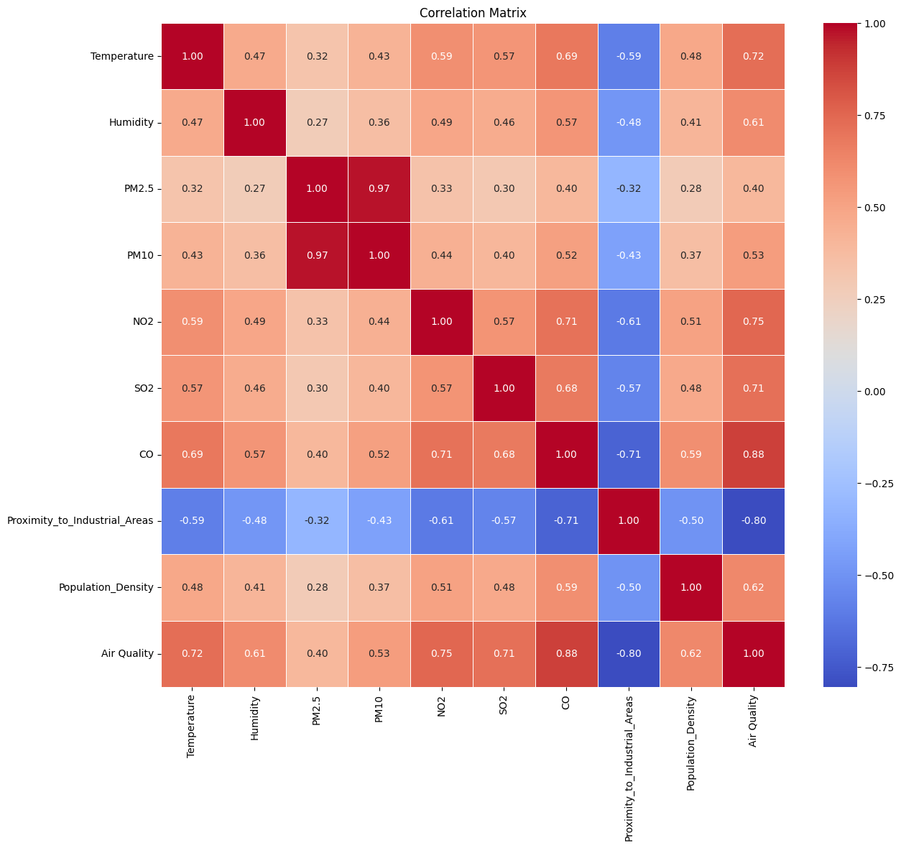
Air quality
The correlation matrix shows that in general, the presence of one pollutant indicates a presence of the others.
All the features are strongly correlated with the Air Quality, so our predictive model should do a decent job of distinguishing each category.

Slide 10
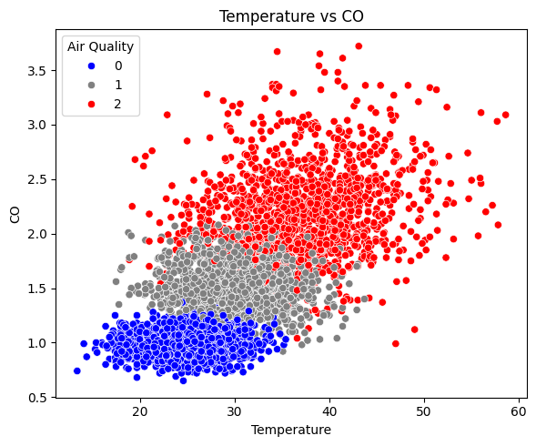
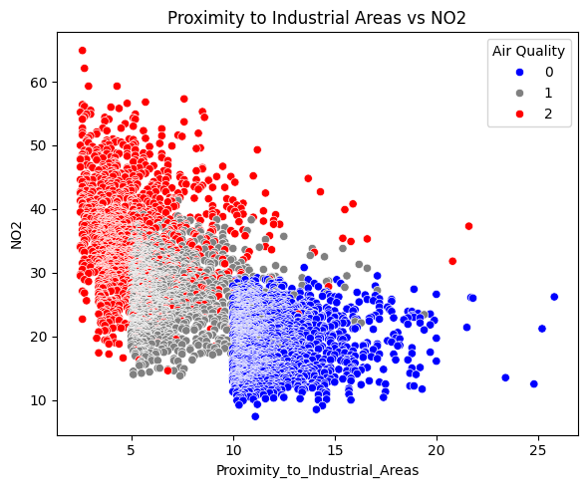

Slide 11
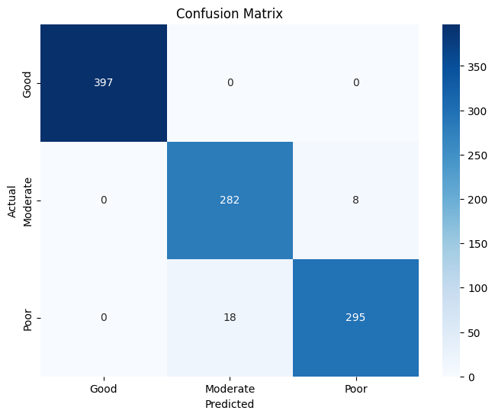
The model
We created a classification model to be able to predict the air quality category of a region based on Temperature, Humidity, Concentrations of PM2.5, PM10, NO2, SO2, CO, Proximity to Industrial areas and Population Density.
We went with a Random Forest model, which performed better than other models like Logistic Regression and XGBoost.
Accuracy Score: 97.4%
The model was perfect in predicting Good air quality, predicted 8 of the moderate wrongly, and 18 of the poor wrongly.
Streamlit application was created, where users can input values for all features and retrieve an air quality level.

Slide 12
Conclusion
Policymakers can use our created threshold levels to revise WHO guidelines.
Urban planners can use the insights when designing residential areas to minimise exposure to pollution.
The Random Forest model achieved 97.4% accuracy, successfully classifying air quality levels based on environmental factors.
The Streamlit apps could be used

Slide 13
The limitations

Slide 14
Thank you for listening, any Questions?

